Slide 1
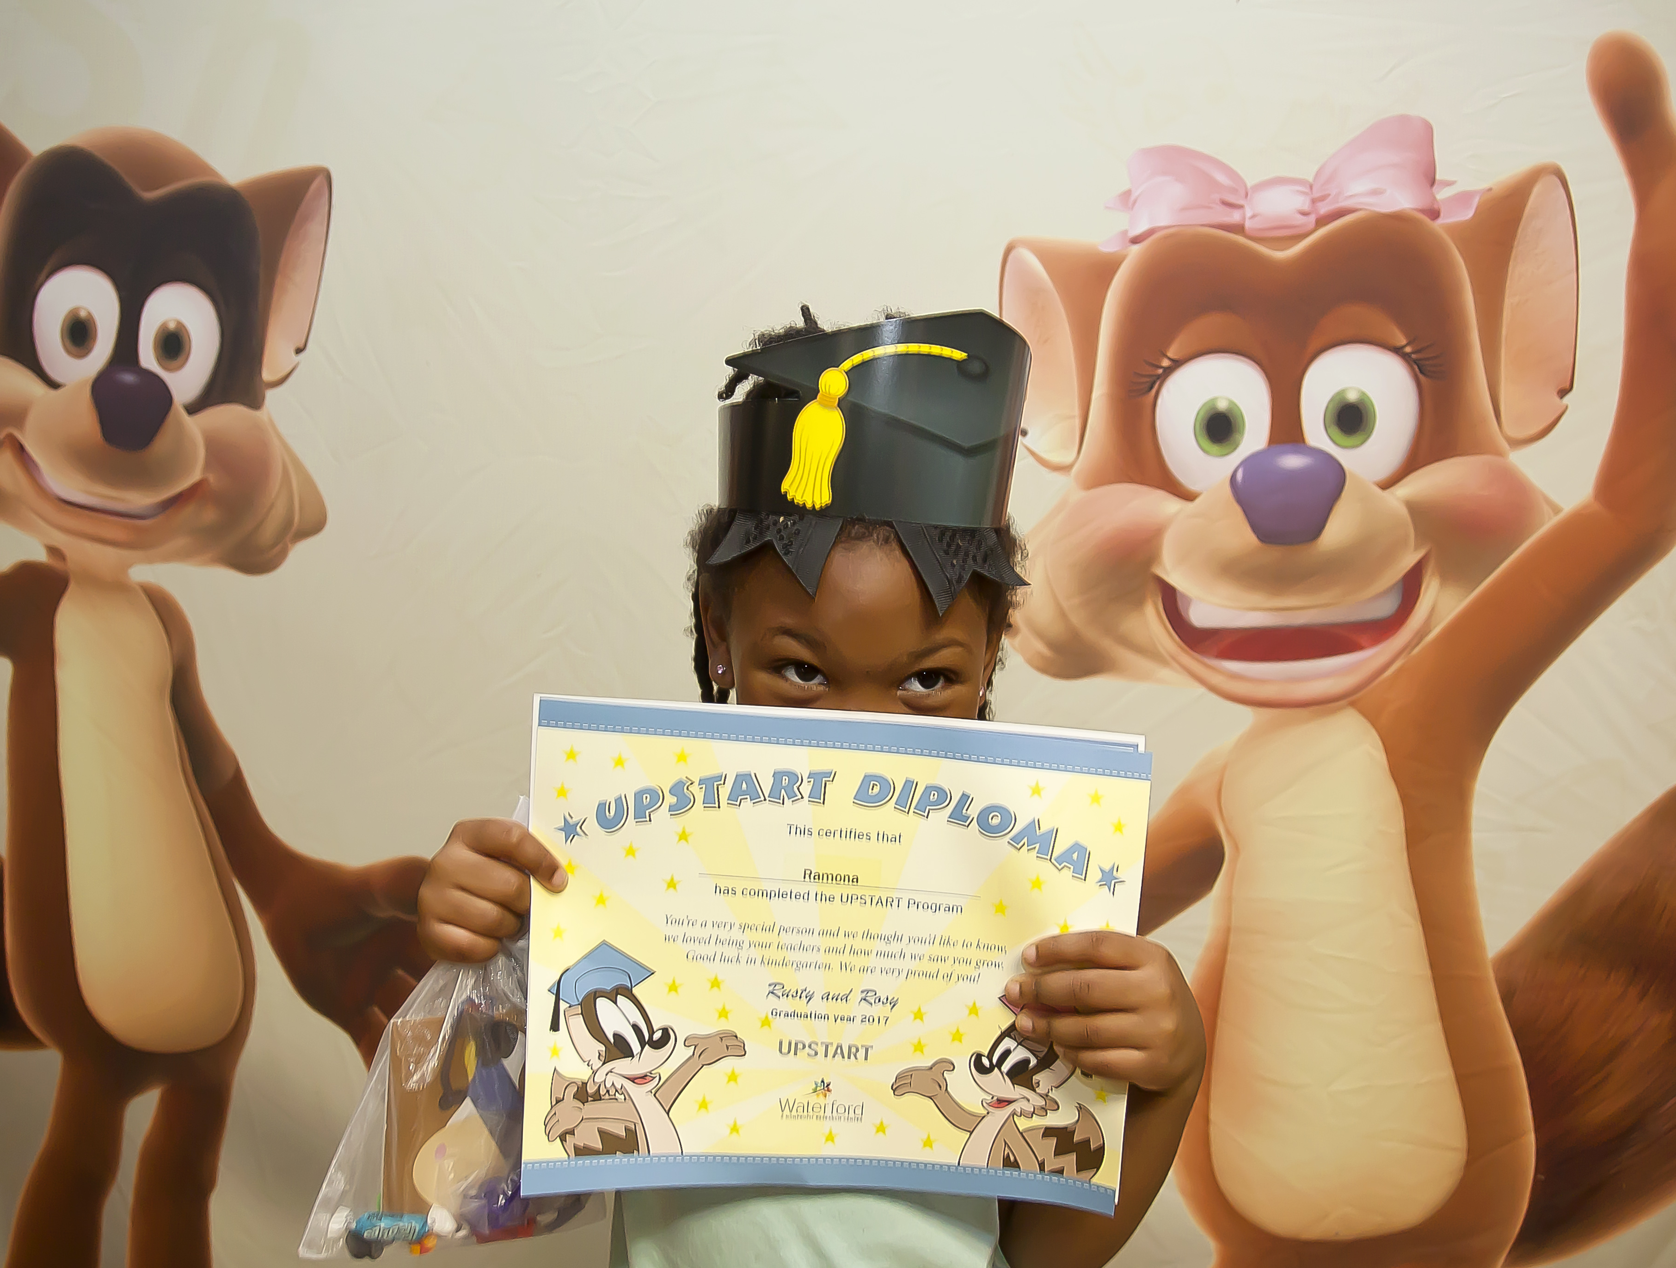
Low-income/Minority children and Education
Marc De La Cruz

Slide 2
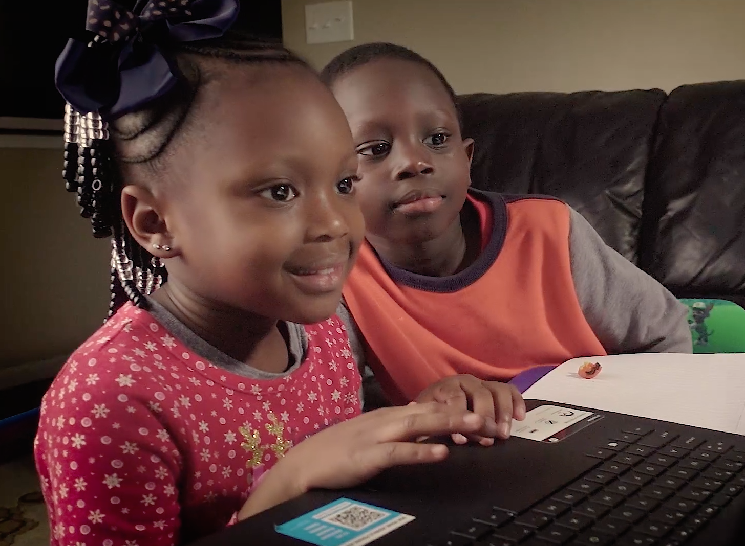
Why it’s a problem
More than 30 million children are growing up in poverty
Children living in poverty have a higher rate of absenteeism
Students from low-income families are 7 times more likely to drop out than regular-income students
40% of children who live in poverty are unprepared for primary schooling
Children that live below the poverty line are 1.3 times more likely to have developmental delays or learning disabilities than those who don’t live in poverty.
By the end of the 4th grade, African-American, Hispanic and low-income students are already 2 years behind grade level. By the time they reach the 12th grade they are 4 years behind.

Slide 3
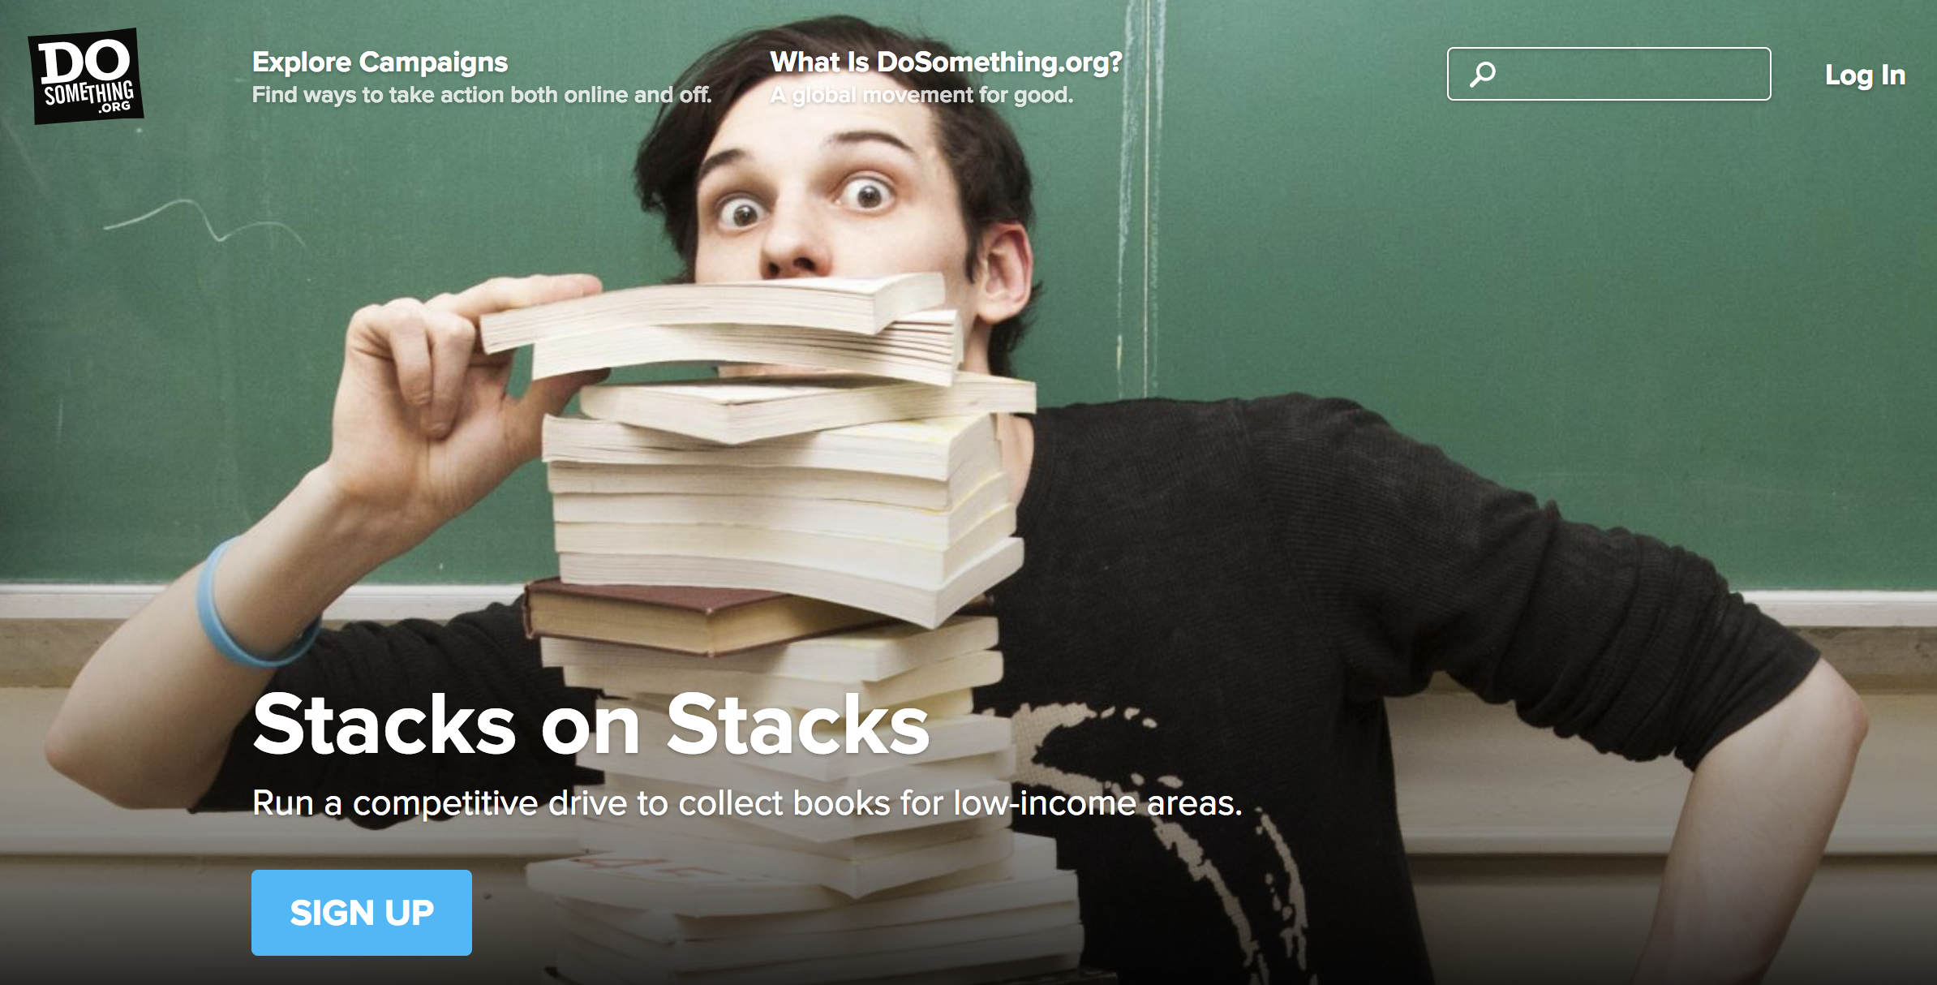
How can we solve this problem
Dosomething.org
Stacks on Stacks
Title 1 funding
Early-Intervention Programs

Slide 4
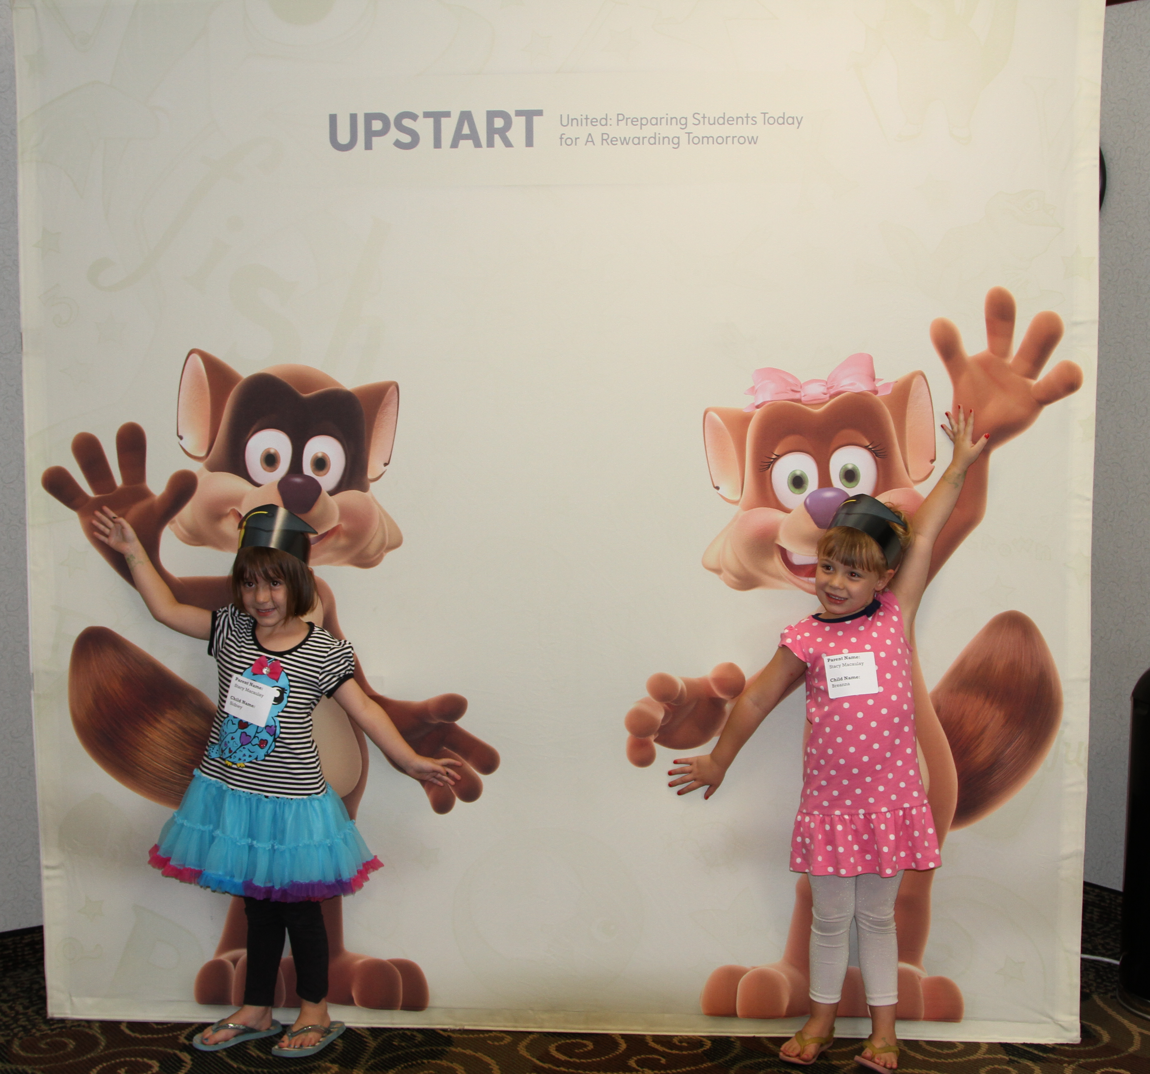
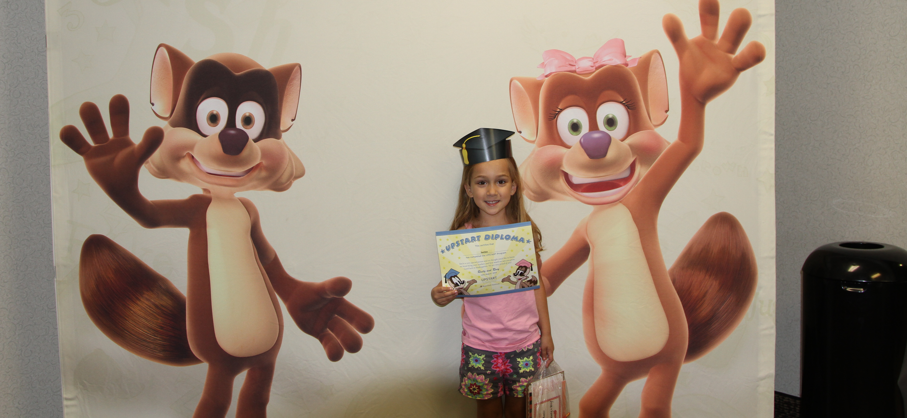
UPSTART Program

Slide 5
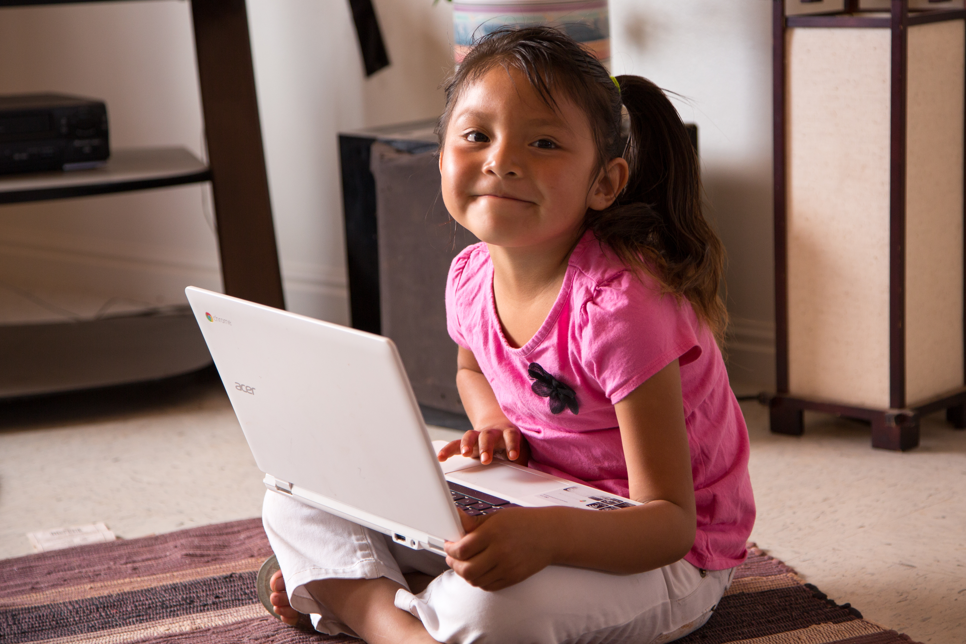
What Is the upstart program
Children in Utah were coming to Kindergarten unprepared to learn.
At the same time, parents had repeatedly signaled an unwillingness to send very young children to school.
Even if parents and caregivers had been willing to send their young children to school, in Utah’s rural areas, transportation presented a huge obstacle to overcome.
UPSTART was designed to solve these problems.

Slide 6
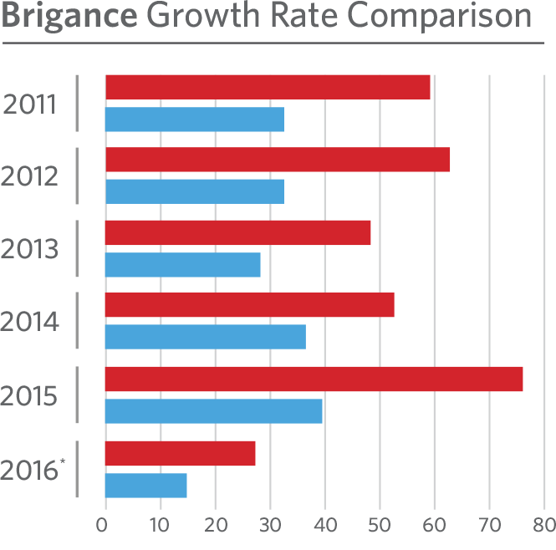
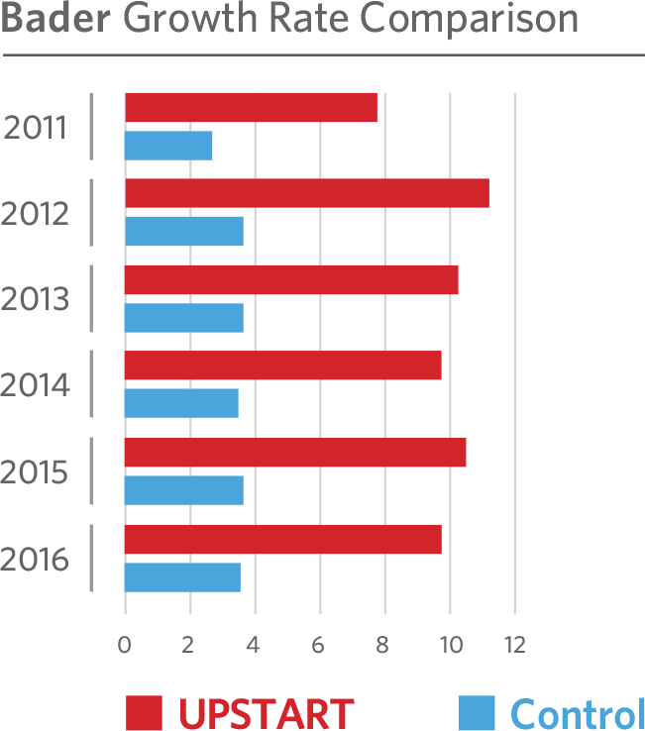

What does the upstart program do
In-home school-readiness program
Individualized reading, math and science curriculum
Partners with parents and caregivers
Provides Computers and Internet to eligible homes without them
About 45,000 Utah children have participated in UPSTART
More than 60% from low-income and Spanish-speaking homes.
More than 14,000 children will participate in UPSTART, which is nearly 30% of all four-year-olds in Utah.
*Total potential scores were lower than previous years because of a testing scale change.

Slide 7
Sources
United States Census Bureau. "Income, Poverty and Health Insurance Coverage in the United States: 2011." United States Census Bureau. Accessed February 18, 2018. .
Save Our Schools, Inc. "Poverty; The Effect on the Whole Child." Save Our Schools March. Accessed March 1, 2018, http://saveourschoolsmarch.org/issues/poverty-and-the-effect-on-education/poverty-the-effect-on-the-whole-child/.
Waterford.org

